Slide 1
Unlocking Automotive Trends
informed decision-making in the automotive industry.

Slide 2
Project Objective
Main Goal:
Analyze a car dataset to identify popular trends and
key factors for launching successful car models.
Action Plan:
Categorize cars based on market segments.
Analyze fuel efficiency and compare performance.
Study weight distribution and assess safety features.
Explore user comfort and analyze alert systems.
Conduct dimensional analysis.
Sprint Focus:
Clean the dataset, segment cars, analyze
key aspects like fuel efficiency and performance, study
weight distribution, and summarize key findings.

Slide 3
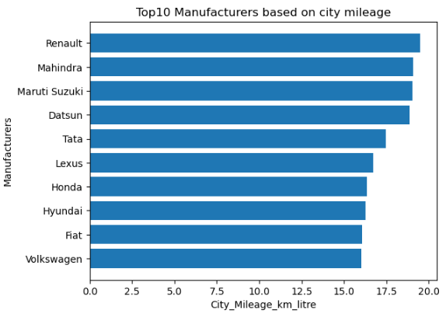
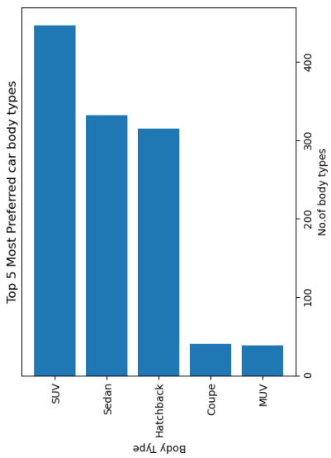
Renault and Mahindra currently lead the pack, the competitive landscape suggests that fuel efficiency will continue to be a key focus for the automotive industry.
the chart provides valuable insights into the preferences of car buyers and highlights the growing popularity of SUVs.

Slide 4
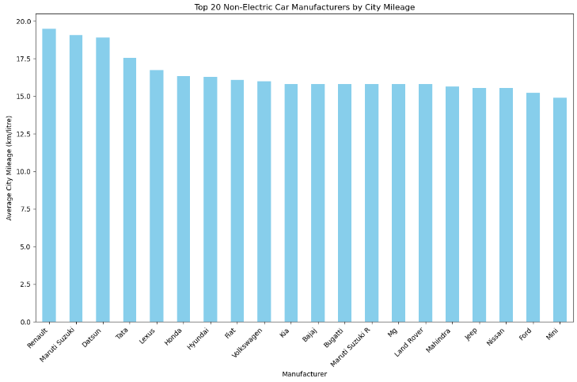
The chart provides a comprehensive overview of the top 20 non-electric car manufacturers in terms of city mileage. While Renault and Maruti Suzuki currently lead the pack, the competitive landscape suggests that fuel efficiency will continue to be a key focus for the automotive industry.

Slide 5
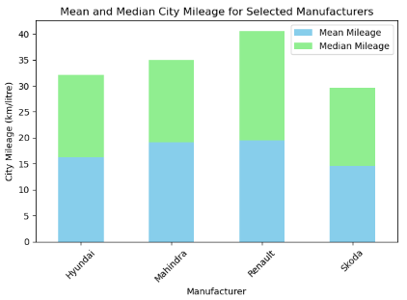
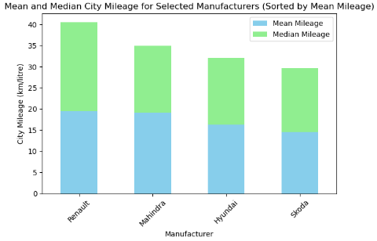
The chart shows the mean and median city mileage for four selected manufacturers. Renault has the highest mean and median mileage, followed by Mahindra, Hyundai, and Skoda. The median mileage for each manufacturer is slightly lower than the mean, indicating some variation in the city mileage of their models.
The chart shows the mean and median city mileage for four selected manufacturers (Renault, Mahindra, Hyundai, and Skoda). Renault has the highest mean and median mileage, followed by Mahindra, Hyundai, and Skoda. The median mileage for each manufacturer is slightly lower than the mean, indicating that there is some variation in the city mileage of their models.

Slide 6
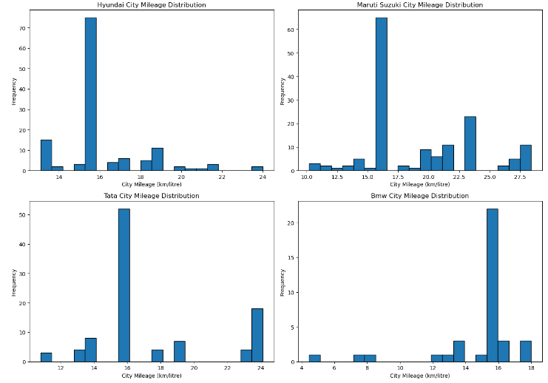
The histograms show the distribution of city mileage for four car brands: Hyundai, Maruti Suzuki, Tata, and BMW. Hyundai and Tata have similar distributions, with a peak around 36 km/litre. Maruti Suzuki has a more spread-out distribution, with a peak around 20 km/litre. BMW has a very narrow distribution, with most cars having a city mileage around 18 km/litre.

Slide 7
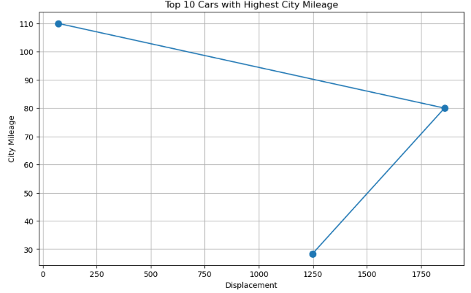
There is a general trend of decreasing city mileage as displacement increases, indicating that larger engines tend to be less fuel-efficient. However, there are also some outliers, such as the car with the highest city mileage and a relatively high displacement

Slide 8
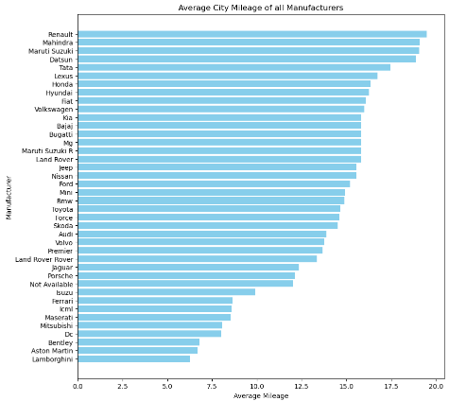

Renault has the highest average city mileage, followed by Mahindra and Maruti Suzuki. Lamborghini has the lowest average city mileage.
Datsun has the highest average highway mileage, followed by Tata and Maruti Suzuki. Lamborghini has the lowest average highway mileage.

Slide 9
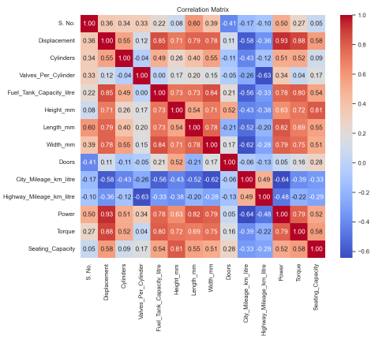
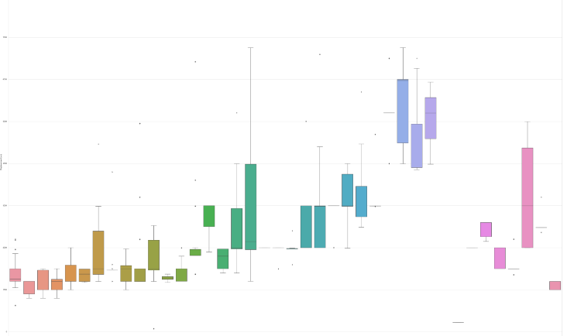
The correlation matrix shows the relationships between different car features. For example, displacement, cylinders, and power are positively correlated with each other, while city and highway mileage are negatively correlated with these features. Seating capacity is not strongly correlated with any of the other features.

Slide 10
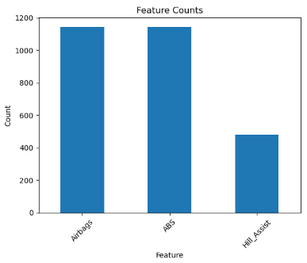
visualizing the Count of car models with each safety feature, After analysing we concluded that ABS_(anti-lock_braking_system) and Airbags are the most common safety feature used by maximum manufacturers ,followed by Hill_Assist.
AVG_Seating capacity is 5.270078740157481total 1127 car models contain central locking and total 1201 car models have child safety.

Slide 11
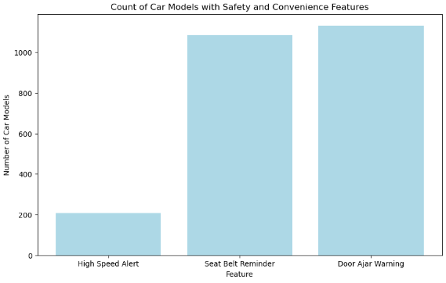
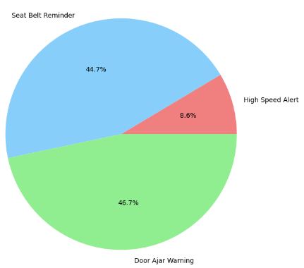
Door Ajar Warnings and Seat belt remainder are the prevalent safety features among the car models

Slide 12
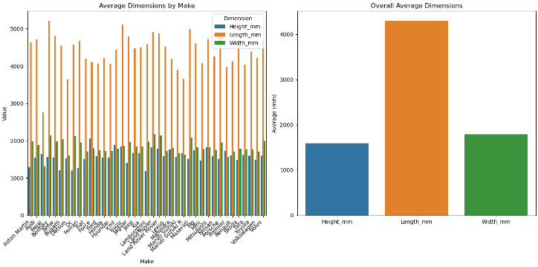
Average Dimensions by Make: Provides the average height, length, and width for each car make, helping identify which makes produce larger or smaller cars.
Overall Average Dimensions: Gives a sense of the average size of cars in the dataset, useful for understanding general market trends.This analysis can be crucial for product planning, as it helps identify size trends and preferences in the market, guiding decisions on new car models and designs.

Slide 13
Consumer Preferences and Market Trends
Fuel Efficiency: There's a strong demand for fuel-efficient vehicles, driving manufacturers to focus on improving city mileage.
SUV Dominance: SUVs have become the most popular car body type, reflecting consumer preferences for versatility and comfort.
Safety Features: ABS, airbags, and hill assist are the most common safety features, indicating a growing emphasis on vehicle safety.
Manufacturer Performance
Renault and Mahindra: These brands consistently outperform others in terms of fuel efficiency.
Diverse Competition: A wide range of manufacturers are offering fuel-efficient vehicles, creating a competitive landscape.
Vehicle Characteristics
Size Trends: The analysis provides insights into the average dimensions of cars, helping manufacturers understand market preferences and design new models accordingly.

Slide 14
Business Conclusions
Prioritize Fuel Efficiency: Continue to invest in research and
development to improve fuel efficiency in both new and existing models.
Expand SUV Offerings: Given the growing popularity of SUVs, manufacturers should consider expanding their SUV lineups.
Focus on Safety Features: Ensure that all new models are equipped with essential safety features like ABS, airbags, and hill assist.
Tailor Vehicle Design: Use data on average vehicle dimensions to design cars that align with consumer preferences and market trends.
Monitor Competition: Keep track of competitors' offerings and strategies to stay competitive in the market.

